Slide 1


I N S I G H T X ’ 23
SELF CHARGING EV-VEHICLES USING SOLAR

Slide 2
TEAM DETAILS
GSD KARTHICK PRANESH
B.Tech AI&DS
Sujitha V
B.Tech AI&DS

Slide 3
INTRODUCTION
Self-charging electric vehicles (EVs) using solar technology represent an innovative approach to sustainable transportation.
These vehicles are equipped with integrated solar panels that harness energy from the sun to recharge their batteries, reducing the need for external charging stations.

Slide 4
GOALS AND OBJECTIVES
The goal of this technology not only extends the range of EVs but also reduces their carbon footprint, making them a promising solution for a greener and more energy-efficient future of mobility.
Its main objrctive is to make Electric Vehicles more efficient and eco-friendly.

Slide 5
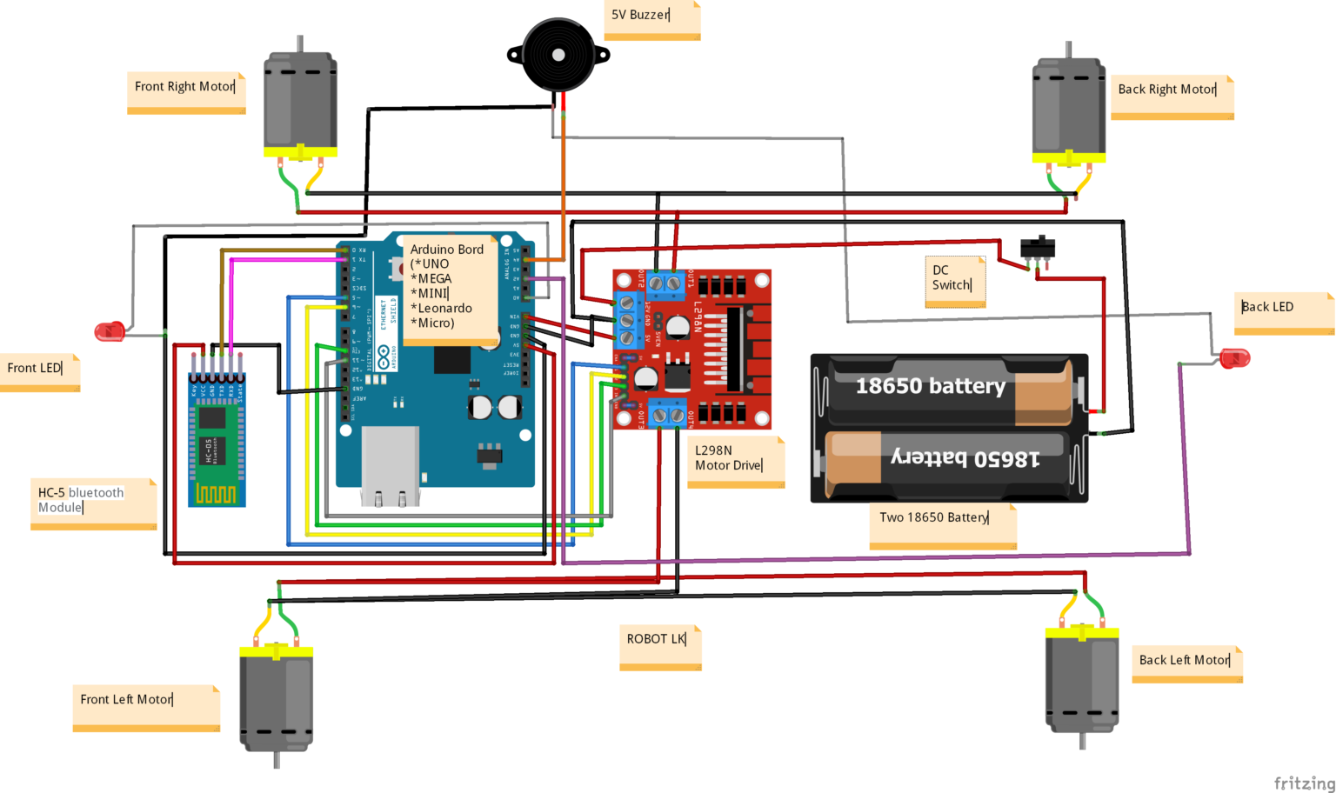
METHODOLOGY

Slide 6
UNIQUENESS
~Here are some key points that highlight its uniqueness:
1.Energy Independence
2.Continuous Charging
3.Sustainability
4.Off-Grid Capabilities
5.Cost Savings
6.Reducing Grid Load
7.Environmental Benefits

Slide 7
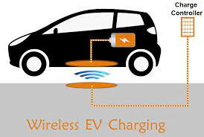
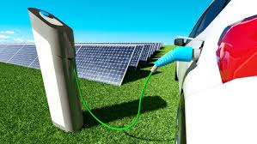
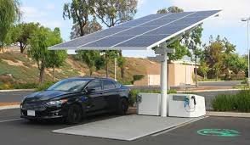
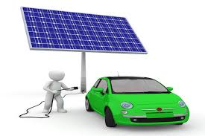
VISUAL REPRESENTATION

Slide 8

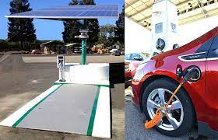
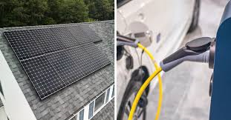
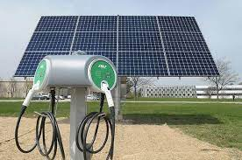
FUTURE DIRECTIONS
Improved Efficiency: Ongoing advancements in solar panel efficiency and energy storage technology will enhance the ability of self-charging EVs to capture and store solar energy effectively.
Integration with EV Design: Future EV models will likely incorporate solar panels seamlessly into their design, optimizing surface area and aesthetics.

Slide 9
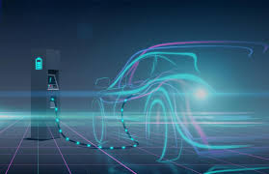
CHALLENGES
01
Charging Infrastructure: The availability of solar charging infrastructure is limited compared to traditional charging stations. Expanding this infrastructure will be necessary to support self-charging EVs.
Consumer Awareness: Many consumers may not be aware of the benefits and capabilities of self-charging EVs using solar technology. Raising awareness and educating potential buyers will be crucial.
02
Market Adoption: The transition from traditional internal combustion engine vehicles to self-charging EVs will take time. Encouraging market adoption and overcoming resistance to change is a significant challenge.
03

Slide 10
CONCLUSION
In conclusion, self-charging electric vehicles (EVs) using solar technology represent a groundbreaking innovation in the world of transportation.
They offer the promise of energy independence, sustainability, and reduced environmental impact by harnessing the sun's power to keep vehicles on the road.

Slide 11

THANK YOU

